Slide 1
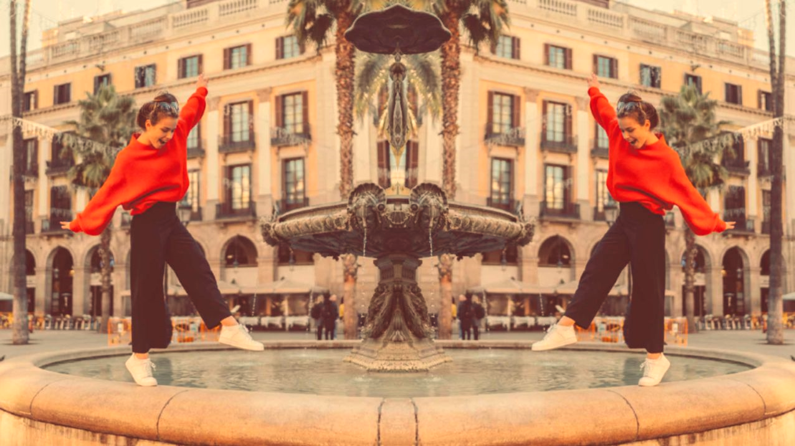
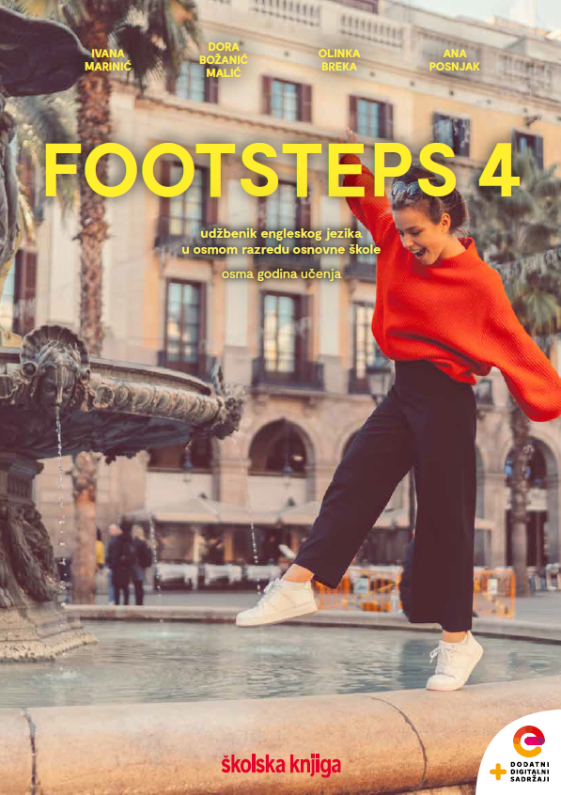

UNIT 1; All too human
Lesson 4; Emotions

Slide 2
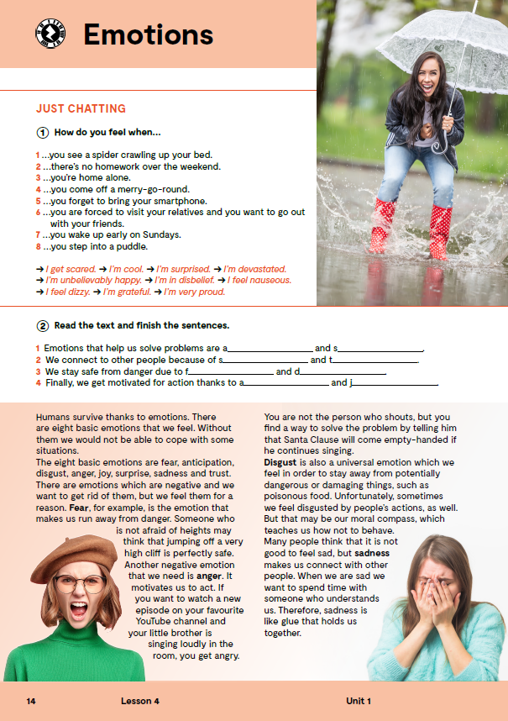
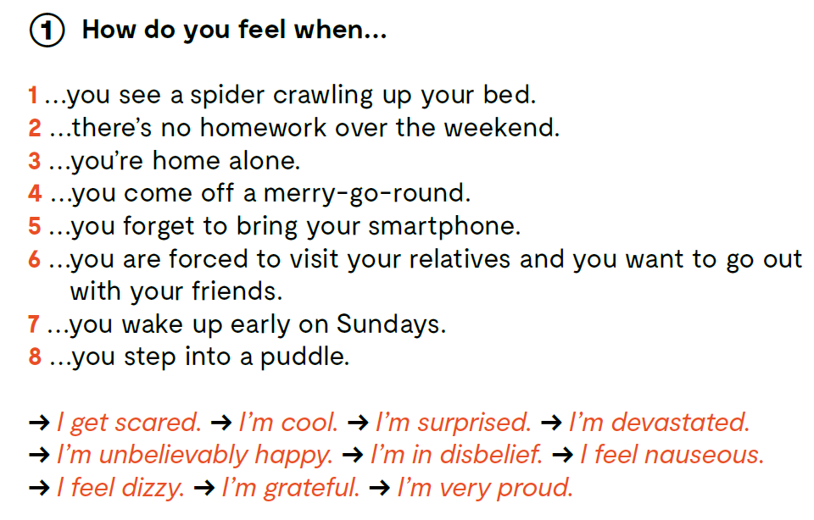

Slide 3
Do you know the meaning of these expressions?
fear
anticipation
disgust
sadness
joy
surprise
trust
anger
nauseous
disbelief
a puddle
a merry-go-round
relatives
strah
iščekivanje
gađenje
tuga
veselje, radost
iznenađenje
povjerenje
ljutnja
gađenje
nepovjerenje, sumnja
lokva
vrtuljak
rođaci

Slide 4

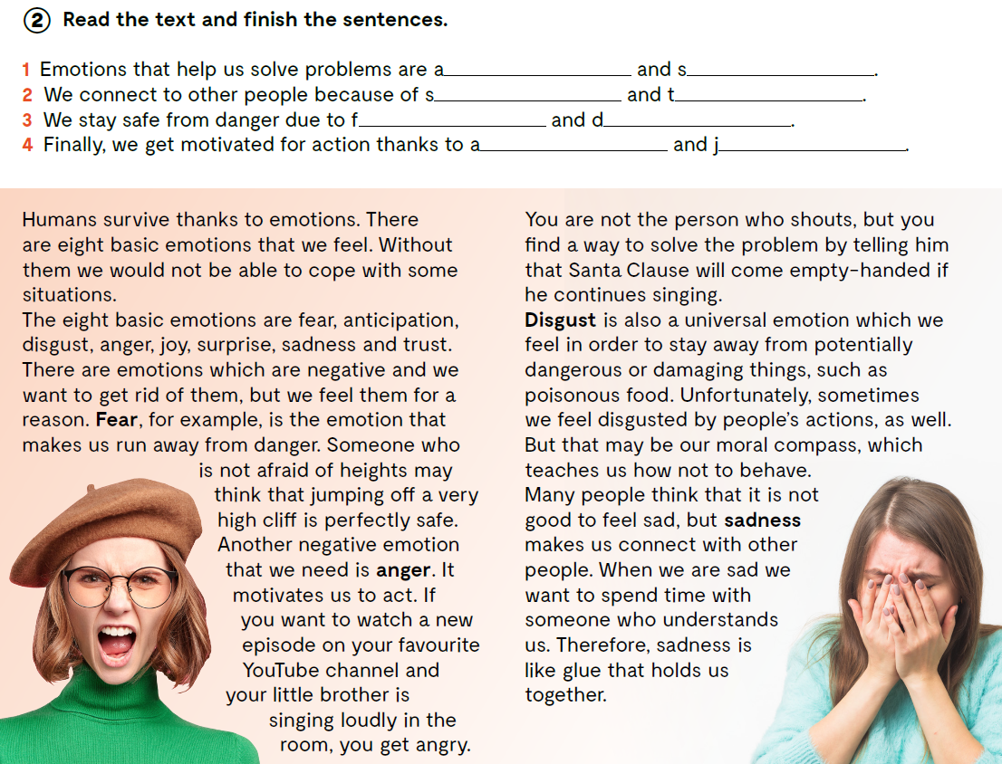

Slide 5
nger
adness
adness
rust
ear
isgust
Do you agree with the statements in the text?
Do we really need emotions to survive?
What are the basic eight emotions?
Why do we need and feel negative emotions?
nger
oy

Slide 6
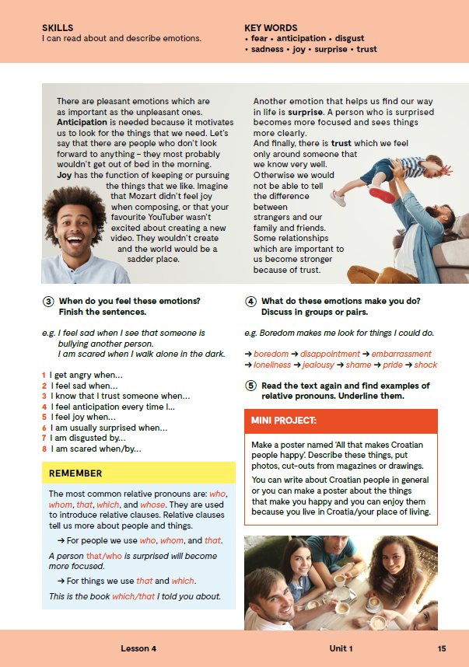
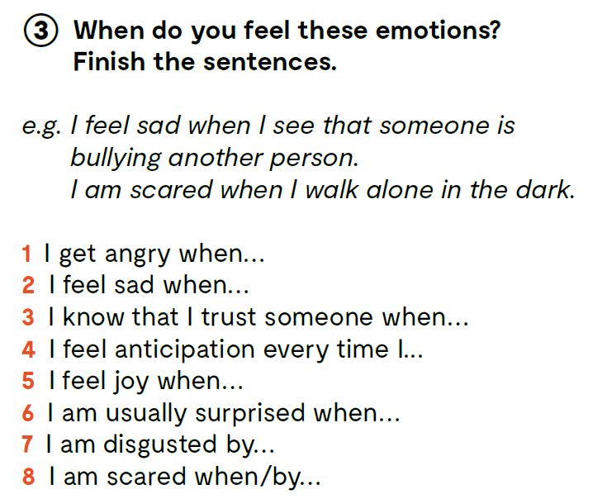

Slide 7
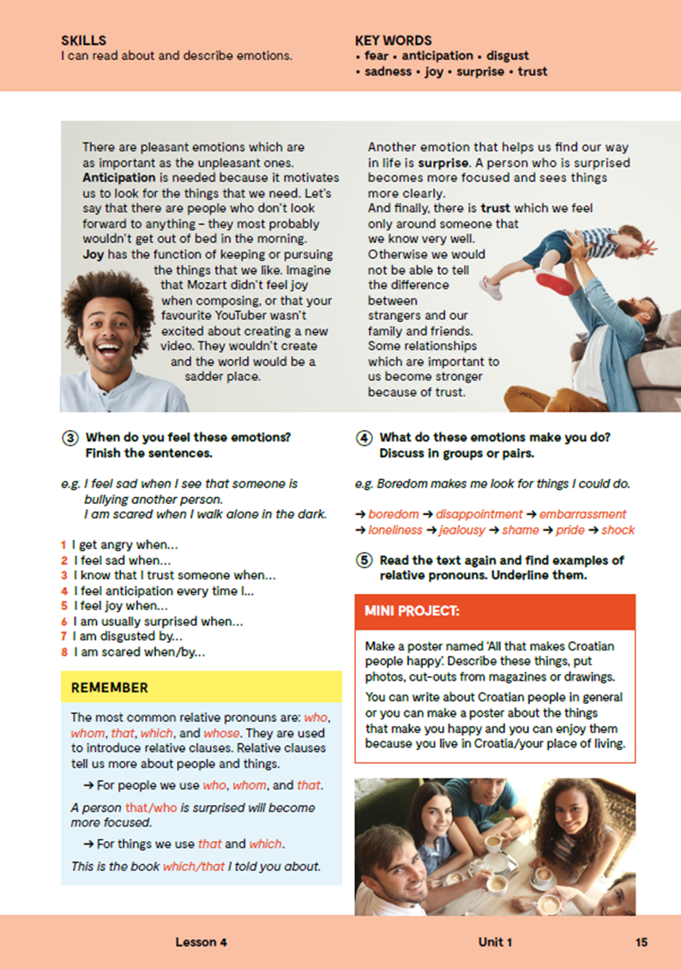
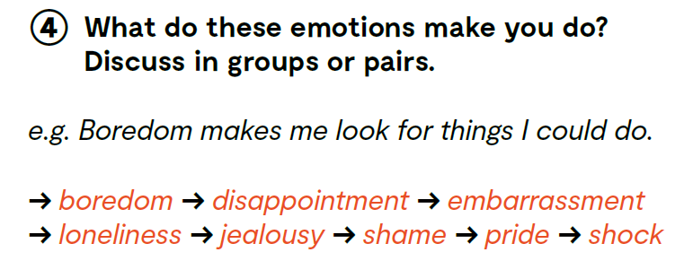
What do these emotions make you do?
boredom = dosada
disappointment = razočaranje
embarrassment = sram
loneliness = samoća
jealousy = ljubomora
shame = sram
pride = ponos
shock = šok

Slide 8
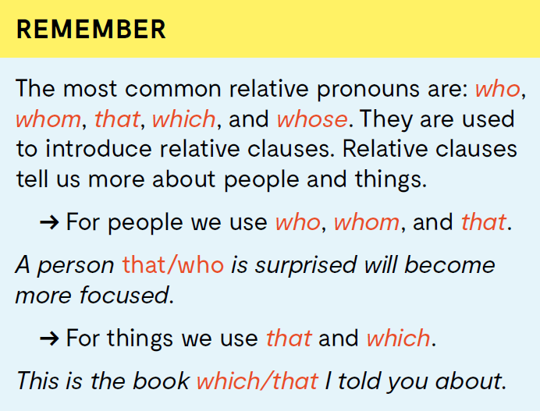


Slide 9
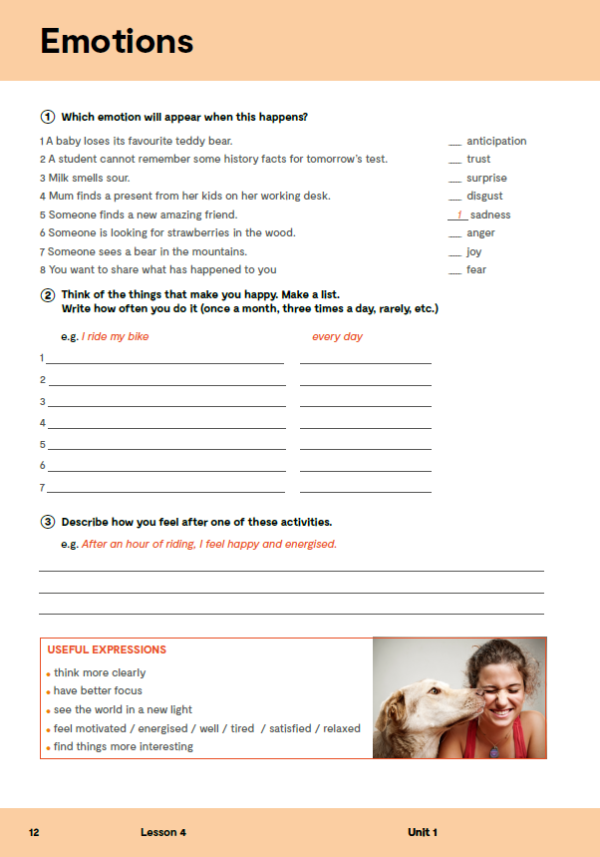
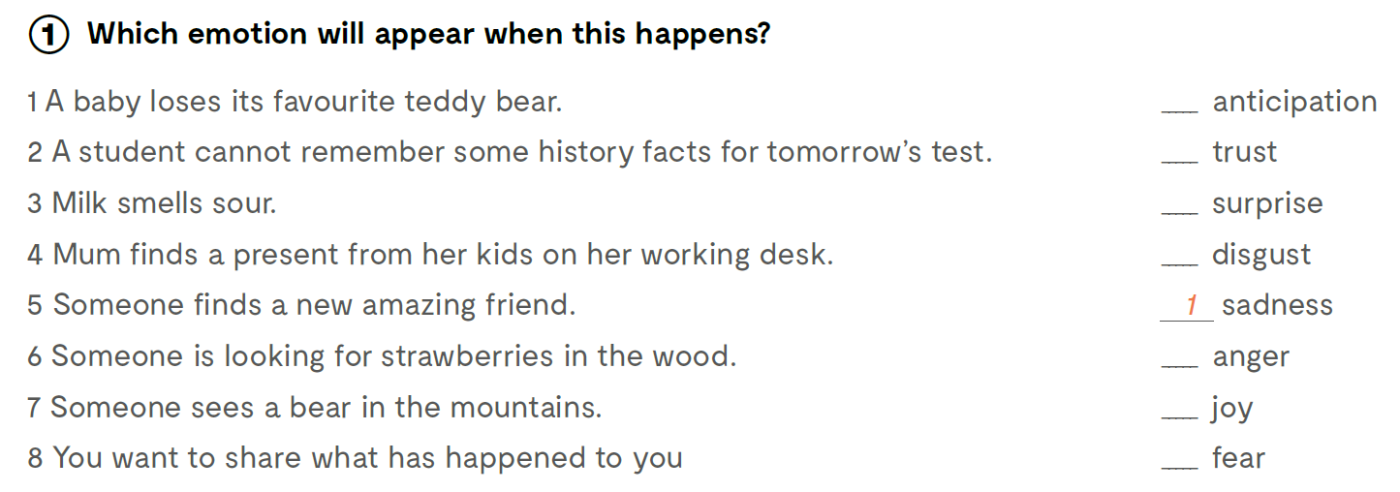
Which emotion will appear when this happens?
6
8
4
3
2
5
7
Check your vocabulary: https://wordwall.net/play/11267/515/827
https://learningapps.org/watch?v=prpgja5un21

Slide 10
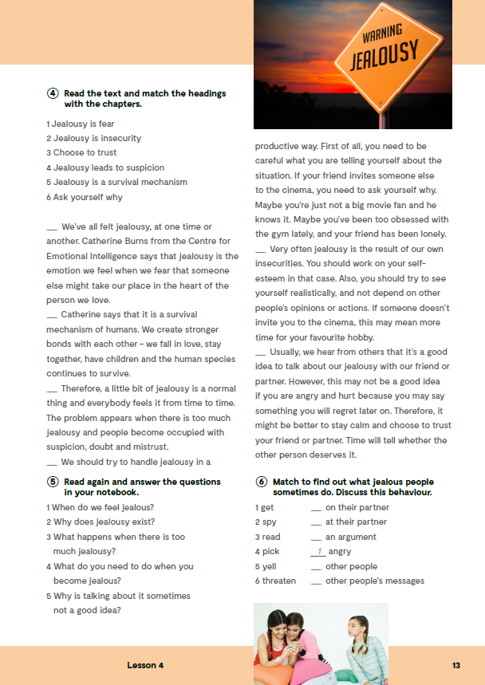
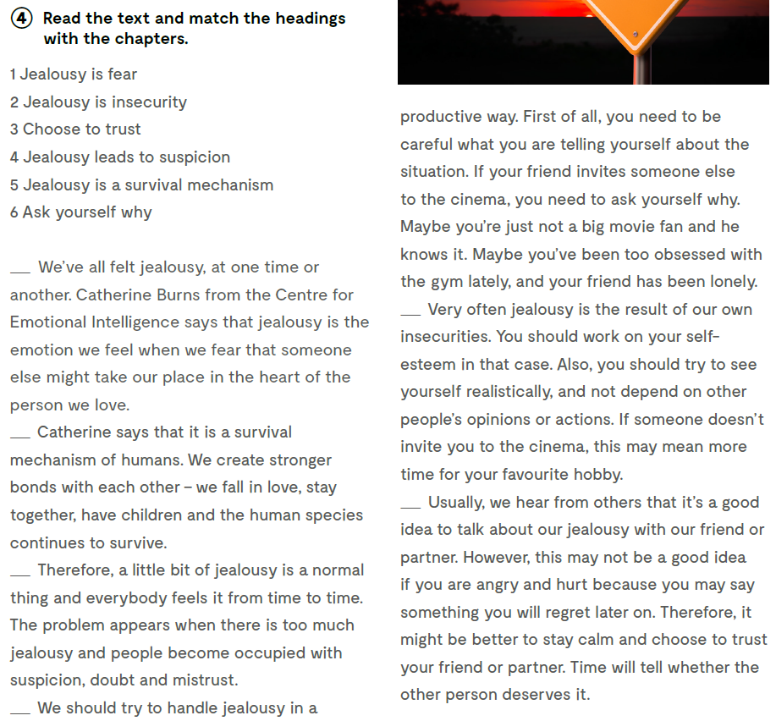
Open your exercise book, page 13.
What are emotions? Što su osjećaji?
Why do we need emotions? Zašto trebamo osjećaje?
Which emotions help us solve problems? Koji osjećaji nam pomažu u rješavanju problema?
Which emotions help us connect to other people? Koji osjećaji nam pomažu da se povežemo s drugim ljudima?
Which emotions help us stay safe from danger? Koji osjećaji nam pomažu kako bismo ostali sigurno od opasnosti?
Which emotions motivate us for action? Koji osjećaji nas motiviraju na akciju?
What is jealousy? Što je ljubomora?
Read the text and match the headings with the chapters.
1
2
5
3
4
6

Slide 11

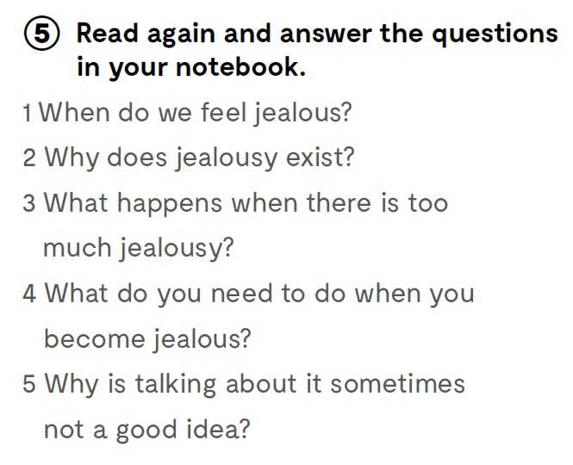
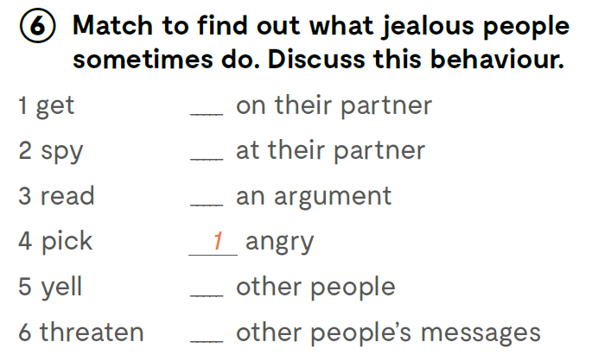
1 naljutiti se
2 špijunirati partnera
3 čitati poruke drugih ljudi
4 započeti svađu
5 vikati na partnera
6 prijetiti drugim ljudima
2
5
4
6
3

Slide 12

LEARN MORE! https://www.e-sfera.hr/dodatni-digitalni-sadrzaji/4fc2c9ae-d9f1-4078-99ae-7fdb3b517ad5/ How do we see ourselves?
Which two children wanted to know more about their names?
Which two asked their parents for help?
Which two took a more scientific approach?
Which two did not completely agree with the result of their research?
Which two mention their own negative traits?
What three personality adjectives would you use to describe each child?
Who would you like to hang out with most? Why?

Slide 13
Find out about your blood type, numerological meaning of your name, or your astrological sign. Did they guess correctly? Or do you disagree?
Is there another way in which you like to describe yourself? ?

Slide 14
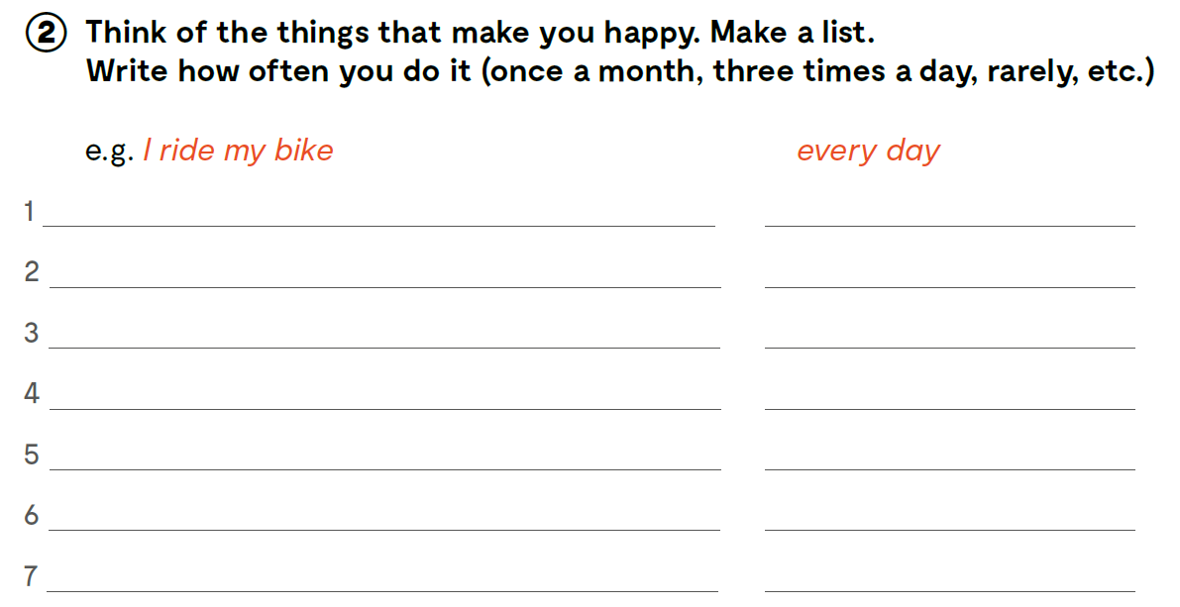

Slide 15

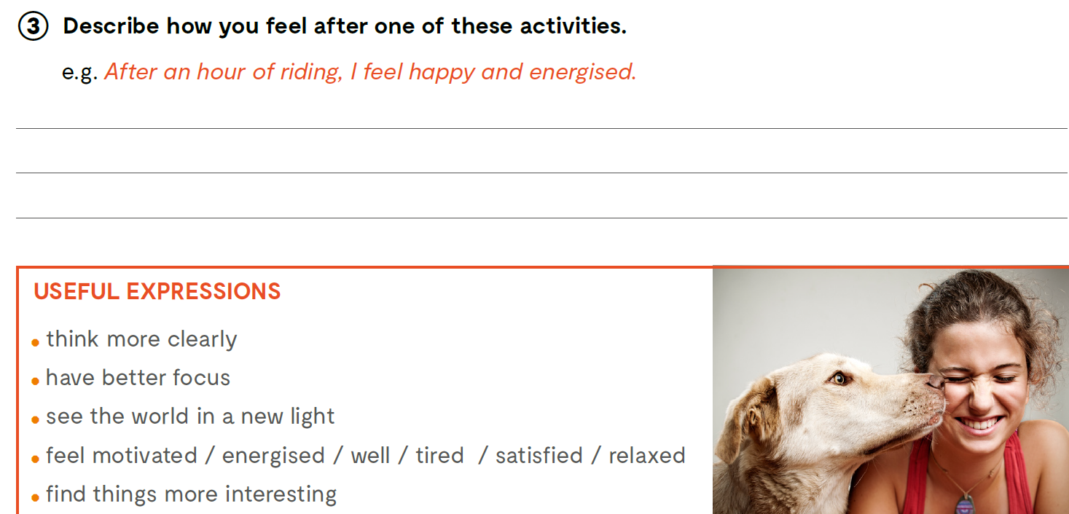

Slide 16
